Slide 1
Experimental Design For Engineers
ISYE435-535

Slide 2
Example 2: Bowler selection
Three bowlers must compete for the last position on the team. They each bowl six games (see data below).

Slide 3
Example 2: Bowler selection
The captain knows better than just to simply pick the bowler with the highest score. Maybe it’s a fluke that Mark scored highest and Pat’s score is low. He wants to know if the scores are significantly different, given the variability in individual scores.

Slide 4
Sample Size Determination
Text, Section 3.7, pg. 103
FAQ in designed experiments
Answer depends on lots of things; including what type of experiment is being contemplated, how it will be conducted, resources, and desired sensitivity
Sensitivity refers to the difference in means that the experimenter wishes to detect
Generally, increasing the number of replications increases the sensitivity or it makes it easier to detect small differences in means

Slide 5
Sample Size Determination
Fixed Effects Case
Can choose the sample size to detect a specific difference in means and achieve desired values of type I and type II errors
Type I error – reject H₀ when it is true ( )
Type II error – fail to reject H₀ when it is false ( )
Power = 1 -
Operating characteristic curves plot against a parameter where

Slide 6
Sample Size Determination
Fixed Effects Case---use of OC Curves
The OC curves for the fixed effects model are in the Appendix, Table V
A very common way to use these charts is to define a difference in two means D of interest, then the minimum value of is
Typically work in term of the ratio of and try values of n until the desired power is achieved
Most statistics software packages will perform power and sample size calculations – see pages 103-104
There are some other methods discussed in the text

Slide 7
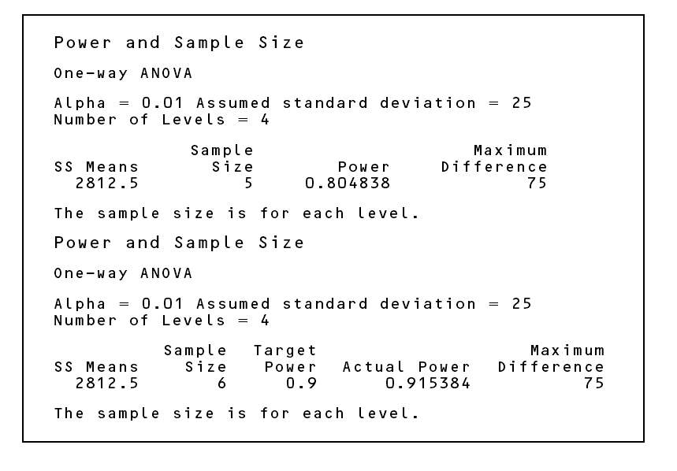
Power and sample size calculations from Minitab (Page 103)

